Slide 1
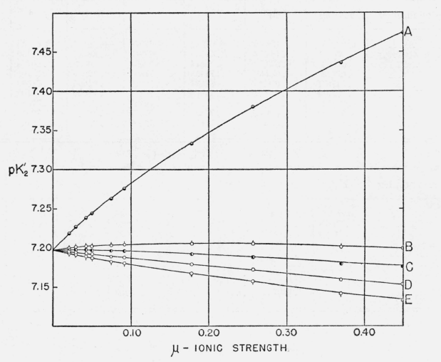
Da: Bates & Acree, 1943, Journal of Research of the National Bureau of Standards, 30: 129

